Slide 1
BUS 297D: Data Mining
Professor David Mease
Lecture 7
Agenda:
1) Go over solutions to HW #3 (due today)
2) Assign HW #4 (due Thursday, October 15)
3) Discuss Final Exam
4) Lecture over Chapter 8

Slide 2
Homework 3
Homework 3 is at
http://www.cob.sjsu.edu/mease_d/bus297D/homework3.html
It is due Thursday, October 1 during class
It is work 50 points
It must be printed out using a computer and turned in during the class meeting time. Anything handwritten on the homework will not be counted. Late homeworks will not be accepted.

Slide 3
Homework 4
Homework 4 is at
http://www.cob.sjsu.edu/mease_d/bus297D/homework4.html
It is due Thursday, October 15 during class
It is work 50 points
It must be printed out using a computer and turned in during the class meeting time. Anything handwritten on the homework will not be counted. Late homeworks will not be accepted.

Slide 4
Final Exam:
The final exam will be Thursday 10/15
Just like with the midterm, you are allowed one 8.5 x 11 inch sheet (front and back) containing notes
No books or computers are allowed, but please bring a hand held calculator
The exam will cover the material from Lectures 5, 6, 7 and 8 and Homeworks #3 and #4 (Chapters 4, 5, 8 and 10) so it is not cumulative
I will put some sample questions on the slides for the next lecture, but in general the questions will be similar to the homework questions (much less multiple choice this time)

Slide 5
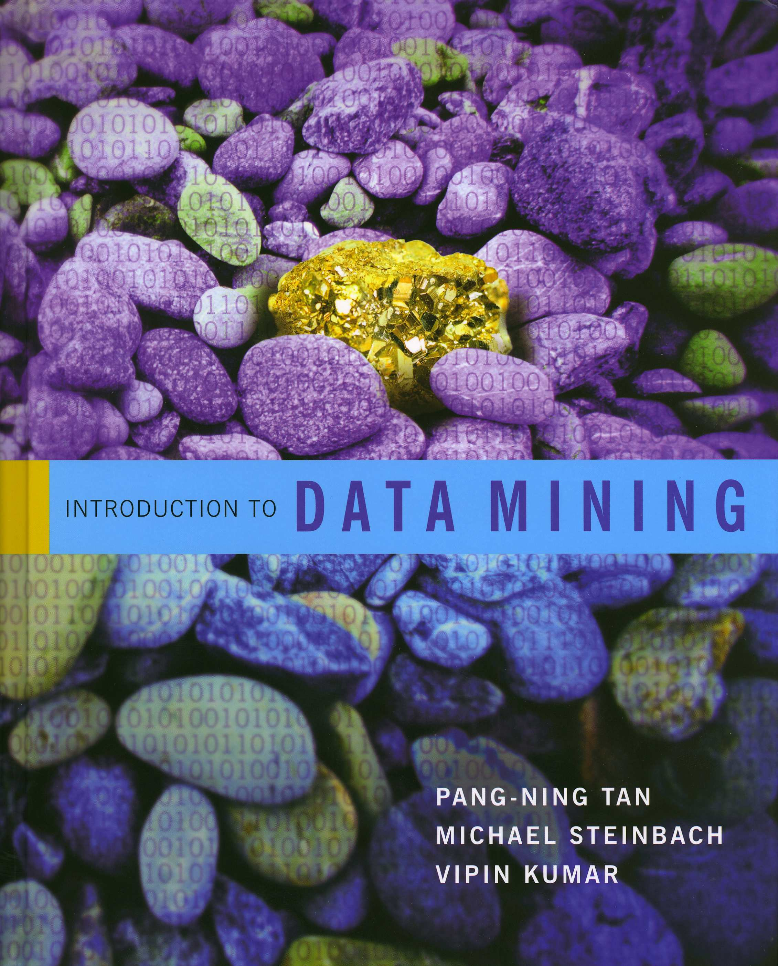
Introduction to Data Mining
by
Tan, Steinbach, Kumar
Chapter 8: Cluster Analysis

Slide 6
What is Cluster Analysis?
“Cluster analysis divides data into groups (clusters) that are meaningful, useful, or both” (page 487)
It is similar to classification, only now we don’t know the “answer” (we don’t have the labels)
For this reason, clustering is often called unsupervised learning while classification is often called supervised learning (page 491 – but the book says “classification” instead of “learning”)
Note that there also exists semi-supervised learning which is a combination of both and is a hot research area right now

Slide 7
What is Cluster Analysis?
Because there is no right answer, your book characterizes clustering as an exercise in descriptive statistics rather than prediction
“Cluster analysis groups data objects based only on information found in the data that describes the objects and their similarities” (page 490)
“The goal is that objects within a group be similar (or related) to one another and different from (or unrelated to) the objects in other groups” (page 490)

Slide 8
Examples of Clustering (P. 488)
Biology: kingdom, phylum, class, order, family, genus, and species
Information Retrieval: search engine query = movie, clusters = reviews, trailers, stars, theaters
Climate: Clusters = regions of similar climate
Psychology and Medicine: patterns in spatial or temporal distribution of a disease
Business: Segment customers into groups for marketing activities

Slide 9
Two Reasons for Clustering (P. 488)
Clustering for Understanding
(see examples from previous slide)
Clustering for Utility
  -Summarizing: different algorithms can run faster on a data set summarized by clustering
  -Compression: storing cluster information is more efficient that storing the entire data - example: quantization
  -Finding Nearest Neighbors

Slide 10
How Many Clusters is Tricky/Subjective
How many clusters?

Slide 11
How Many Clusters is Tricky/Subjective
How many clusters?
Two Clusters

Slide 12
How Many Clusters is Tricky/Subjective
How many clusters?
Two Clusters
Four Clusters

Slide 13
How Many Clusters is Tricky/Subjective
How many clusters?
Six Clusters
Two Clusters
Four Clusters

Slide 14
K-Means Clustering
K-means clustering is one of the most common/popular techniques
Each cluster is associated with a centroid (center point) – this is often the mean – it is the cluster prototype
Each point is assigned to the cluster with the closest centroid
The number of clusters, K, must be specified ahead of time

Slide 15
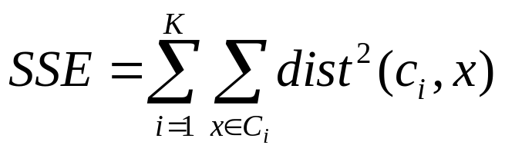
K-Means Clustering
The most common version of k-means minimizes the sum of the squared distances of each point from its cluster center (page 500)
For a given set of cluster centers, (obviously) each point should be matched to the nearest center
For a given cluster, the best center is the mean
The basic algorithm is to iterate over these two relationships

Slide 16
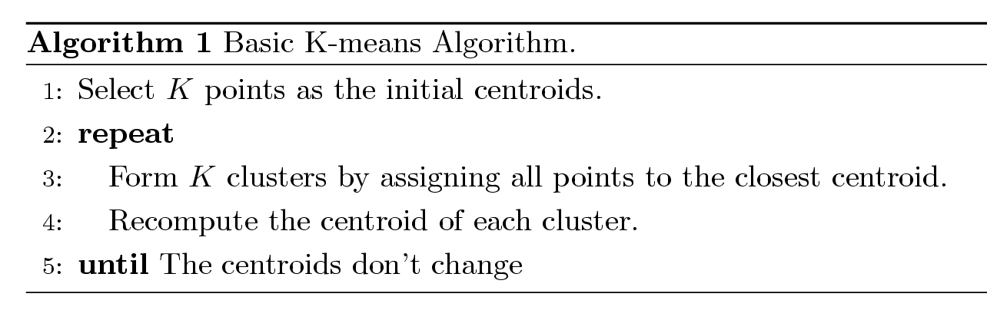
K-Means Clustering Algorithms
This is Algorithm 8.1 on page 497 of your text
Other algorithms also exist
In R, the function kmeans() does k means clustering – no special package or library is needed

Slide 17
In class exercise #49:
Use kmeans() in R with all the default values to find the k=2 solution for the 2-dimensional data at
http://www-stat.wharton.upenn.edu/~dmease/cluster.csv
Plot the data. Also plot the fitted cluster centers using a different color. Finally, use the knn() function to assign the cluster membership for the points to the nearest cluster center. Color the points according to their cluster membership.

Slide 18
In class exercise #49:
Use kmeans() in R with all the default values to find the k=2 solution for the 2-dimensional data at
http://www-stat.wharton.upenn.edu/~dmease/cluster.csv
Plot the data. Also plot the fitted cluster centers using a different color. Finally, use the knn() function to assign the cluster membership for the points to the nearest cluster center. Color the points according to their cluster membership.
Solution:
x<-read.csv("cluster.csv",header=F)
plot(x,pch=19,xlab=expression(x[1]),
ylab=expression(x[2]))
fit<-kmeans(x, 2)
points(fit$centers,pch=19,col="blue",cex=2)

Slide 19
In class exercise #49:
Use kmeans() in R with all the default values to find the k=2 solution for the 2-dimensional data at
http://www-stat.wharton.upenn.edu/~dmease/cluster.csv
Plot the data. Also plot the fitted cluster centers using a different color. Finally, use the knn() function to assign the cluster membership for the points to the nearest cluster center. Color the points according to their cluster membership.
Solution (continued):
library(class)
knnfit<-knn(fit$centers,x,as.factor(c(-1,1)))
points(x,col=1+1*as.numeric(knnfit),pch=19)

Slide 20
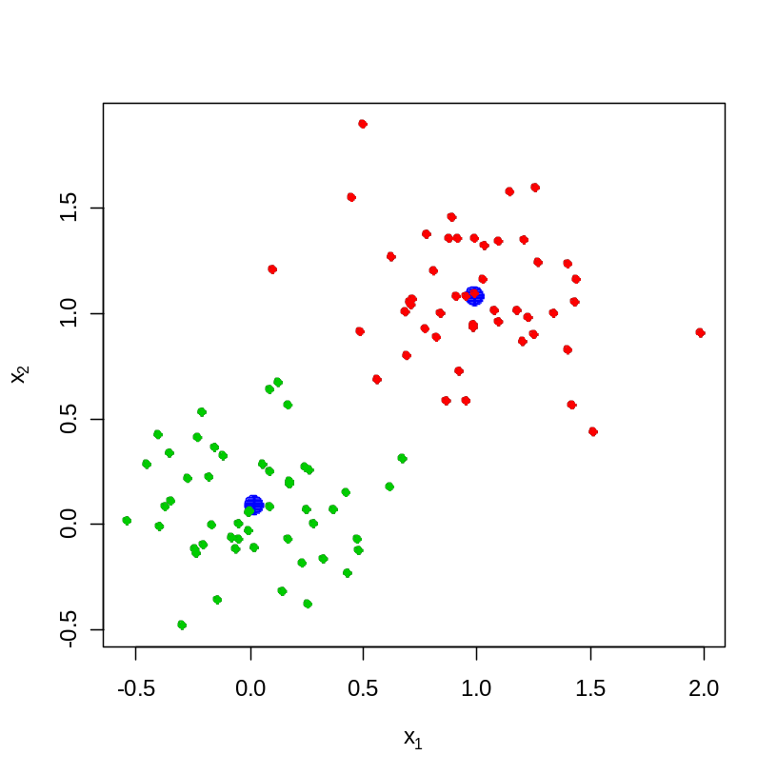
In class exercise #49:
Use kmeans() in R with all the default values to find the k=2 solution for the 2-dimensional data at
http://www-stat.wharton.upenn.edu/~dmease/cluster.csv
Plot the data. Also plot the fitted cluster centers using a different color. Finally, use the knn() function to assign the cluster membership for the points to the nearest cluster center. Color the points according to their cluster membership.
Solution (continued):

Slide 21
In class exercise #50:
Use kmeans() in R with all the default values to find the k=2 solution for the first two columns of the sonar training data at
http://www-stat.wharton.upenn.edu/~dmease/sonar_train.csv
Plot these two columns. Also plot the fitted cluster centers using a different color. Finally, use the knn() function to assign the cluster membership for the points to the nearest cluster center. Color the points according to their cluster membership.

Slide 22
In class exercise #50:
Use kmeans() in R with all the default values to find the k=2 solution for the first two columns of the sonar training data at
http://www-stat.wharton.upenn.edu/~dmease/sonar_train.csv
Plot these two columns. Also plot the fitted cluster centers using a different color. Finally, use the knn() function to assign the cluster membership for the points to the nearest cluster center. Color the points according to their cluster membership.
Solution:
data<-read.csv("sonar_train.csv",header=FALSE)
x<-data[,1:2]
plot(x,pch=19,xlab=expression(x[1]),
ylab=expression(x[2]))

Slide 23
In class exercise #50:
Use kmeans() in R with all the default values to find the k=2 solution for the first two columns of the sonar training data at
http://www-stat.wharton.upenn.edu/~dmease/sonar_train.csv
Plot these two columns. Also plot the fitted cluster centers using a different color. Finally, use the knn() function to assign the cluster membership for the points to the nearest cluster center. Color the points according to their cluster membership.
Solution (continued):
fit<-kmeans(x, 2)
points(fit$centers,pch=19,col="blue",cex=2)

Slide 24
In class exercise #50:
Use kmeans() in R with all the default values to find the k=2 solution for the first two columns of the sonar training data at
http://www-stat.wharton.upenn.edu/~dmease/sonar_train.csv
Plot these two columns. Also plot the fitted cluster centers using a different color. Finally, use the knn() function to assign the cluster membership for the points to the nearest cluster center. Color the points according to their cluster membership.
Solution (continued):
library(class)
knnfit<-knn(fit$centers,x,as.factor(c(-1,1)))
points(x,col=1+1*as.numeric(knnfit),pch=19)

Slide 25
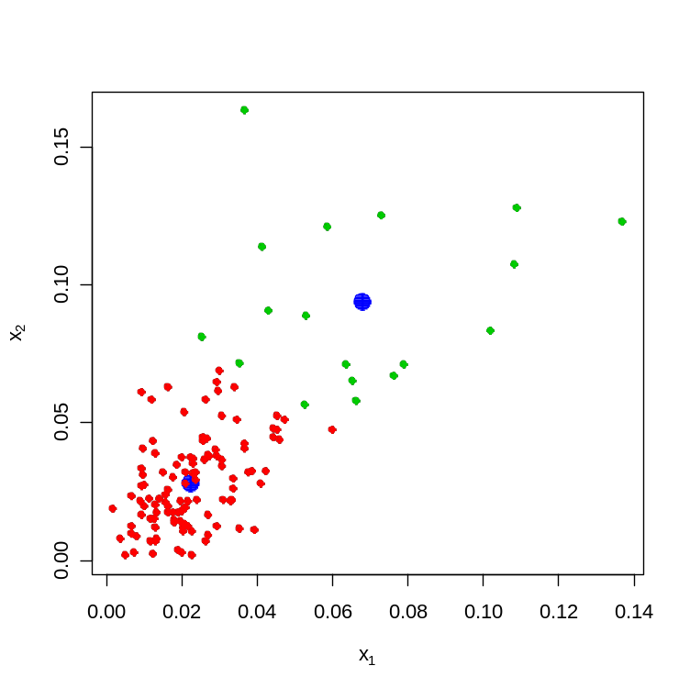
In class exercise #50:
Use kmeans() in R with all the default values to find the k=2 solution for the first two columns of the sonar training data at
http://www-stat.wharton.upenn.edu/~dmease/sonar_train.csv
Plot these two columns. Also plot the fitted cluster centers using a different color. Finally, use the knn() function to assign the cluster membership for the points to the nearest cluster center. Color the points according to their cluster membership.
Solution (continued):

Slide 26
In class exercise #51:
Graphically compare the cluster memberships from the previous problem to the actual labels in the training data.

Slide 27
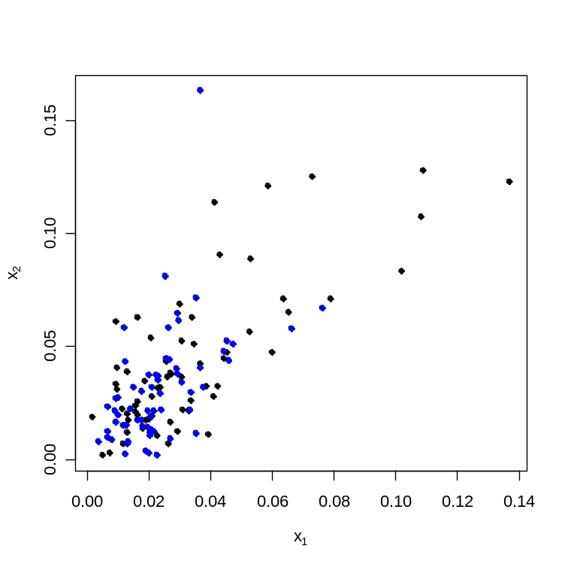
In class exercise #51:
Graphically compare the cluster memberships from the previous problem to the actual labels in the training data.
Solution:
plot(x,pch=19,xlab=expression(x[1]),
ylab=expression(x[2]))
y<-data[,61]
points(x,col=2+2*y,pch=19)

Slide 28
In class exercise #52:
For the previous exercise compute the misclassification error that would result if you used your clustering rule to classify the data.

Slide 29
In class exercise #52:
For the previous exercise compute the misclassification error that would result if you used your clustering rule to classify the data.
Solution:
1-sum(knnfit==y)/length(y)

Slide 30
In class exercise #53:
Repeat the previous exercise using all 60 columns.

Slide 31
In class exercise #53:
Repeat the previous exercise using all 60 columns.
Solution:
x<-data[,1:60]
fit<-kmeans(x, 2)
library(class)
knnfit<-knn(fit$centers,x,as.factor(c(-1,1)))
1-sum(knnfit==y)/length(y)

Slide 32
In class exercise #54:
Consider the one-dimensional data set given by
x<-c(1,2,3,5,6,7,8) (I left out 4 on purpose). Starting with initial cluster center values of 1 and 2 carry out algorithm 8.1 until convergence by hand for k=2 clusters.

Slide 33
In class exercise #55:
Repeat the previous exercise by writing a loop in R and verify that the final answer is the same.

Slide 34
In class exercise #55:
Repeat the previous exercise by writing a loop in R and verify that the final answer is the same.
Solution:
x<-c(1,2,3,5,6,7,8)
center1<-1
center2<-2
for (k in 2:10){
cluster1<-x[abs(x-center1[k-1])<=abs(x-center2[k-1])]
cluster2<-x[abs(x-center1[k-1])>abs(x-center2[k-1])]
center1[k]<-mean(cluster1)
center2[k]<-mean(cluster2)
}

Slide 35
In class exercise #56:
Verify that the kmeans function in R gives the same solution for the previous exercise when you use all of the default values.

Slide 36
In class exercise #56:
Verify that the kmeans function in R gives the same solution for the previous exercise when you use all of the default values.
Solution:
kmeans(x,2)

Slide 37
Measuring Distance
Many of the techniques for clustering and classification rely on some notion of distance
Section 2.4 in the book discusses different ways of measuring distance (dissimilarity)
For numeric variables, the distance you are used to is called Euclidean distance, but other methods exist
For categorical variables or mixtures of categorical and numeric variables it is tricky to compute distance
Remember, scaling is important if scales differ

Slide 38
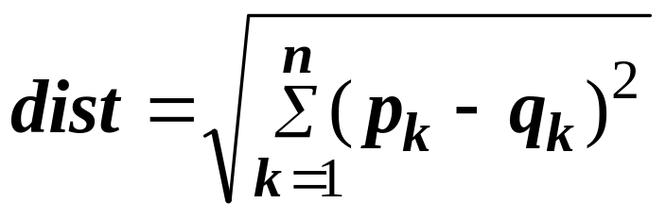
Euclidean Distance (P.69)
Euclidean distance is the usual method of computing distance that you are used to
In 1 dimension it is the absolute value
In 2 dimensions it is the Pythagorean Theorem
In more than 2 dimensions it is just a generalization of the Pythagorean Theorem
In R, the function dist() computes distances

Slide 39
In class exercise #57:
Compute the distance between the points c(2,2) and c(5,7) by hand and verify that the function dist in R gives the same value.

Slide 40
In class exercise #57:
Compute the distance between the points c(2,2) and c(5,7) by hand and verify that the function dist in R gives the same value.
Solution:
x1<-c(2,2)
x2<-c(5,7)
data<-matrix(c(x1,x2),nrow=2,byrow=T)
dist(data)

Slide 41
In class exercise #58:
Compute the distance between the points c(2,2,3) and c(5,7,10) by hand and verify that the function dist in R gives the same value.

Slide 42
In class exercise #58:
Compute the distance between the points c(2,2,3) and c(5,7,10) by hand and verify that the function dist in R gives the same value.
Solution:
x1<-c(2,2,3)
x2<-c(5,7,10)
data<-matrix(c(x1,x2),nrow=2,byrow=T)
dist(data)

